Slide 1
Application Layer
Vs
Transport Layer
By Bimal Gaire

Slide 2
Application Layer
7th layer of OSI Model
Runs on application level
It is near to user-end. User interacts to the network through Application Layer.
End system communicate over the network
Some Protocols:
HTTP,FTP,SMTP

Slide 3
Application Architecture
Client Server
Peer to Peer
Hybrid: Chatting System, Skype

Slide 4
Process: program running within a host.
Client process: process that initiates communication
Server process: process that initiates communication
processes in different hosts communicate by exchanging messages

Slide 5
HTTP uses TCP
Establish TCP Connection
Persistent and Non Persistent HTTP
HTTP is stateless
Uses Cookies

Slide 6
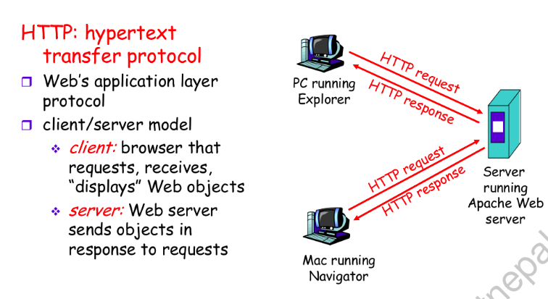
HTTP:

Slide 7
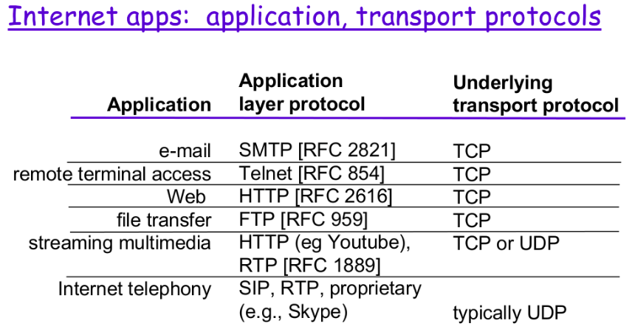
Protocols:

Slide 8
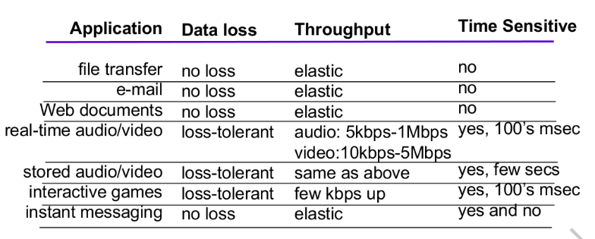
Requirement:

Slide 9
Web cache
DNS

Slide 10
Transport Layer
Transmit the data between two ends.
Provide logical communication between app processes running on different hosts
transport protocols run in
end systems
Internet: TCP and UDP

Slide 11
sender side: breaks application messages into segments, passes to network layer
receiver side: reassembles segments into messages, passes to application layer

Slide 12
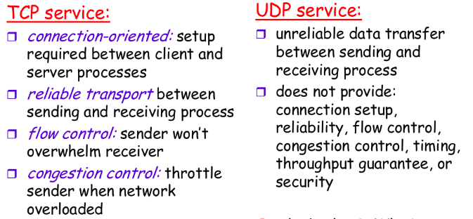
TCP Vs UDP

Slide 13
Things Done
Retransmission of data if it fails at previous attempt
flow control
Congestion Control
Error control.

Slide 14
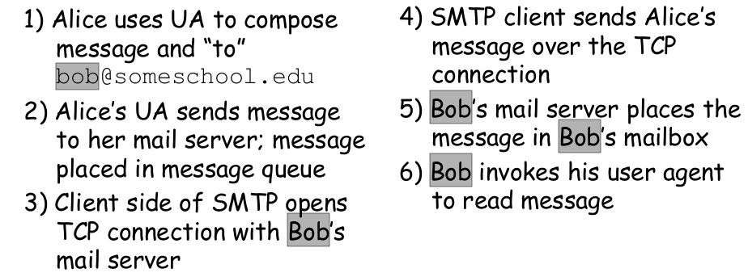
Alice sends message to Bob

Slide 15
Thank You!!!

